Slide 1
NLP Project Presentation
By - Mustafa EP20B025

Slide 2
Limitations addressed
Sensitivity to weighting schemes
Similar words capture
Word embeddings for semantic context

Slide 3

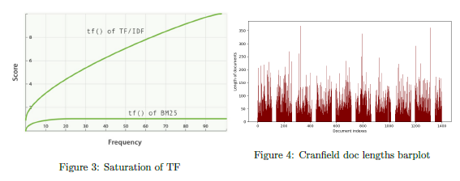
BM25 weight scheme

Slide 4
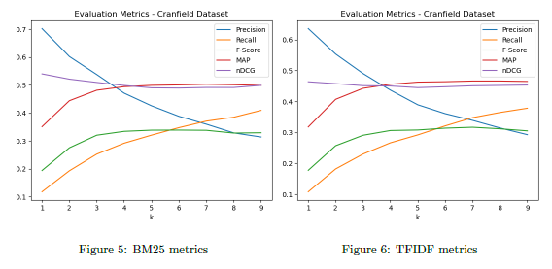
BM25 metrics

Slide 5
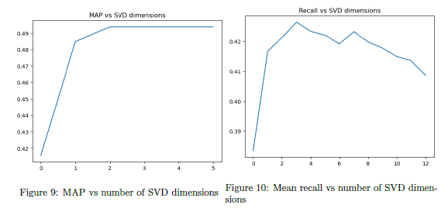
LSA with SVD

Slide 6
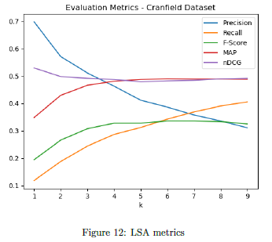
LSA metrics

Slide 7
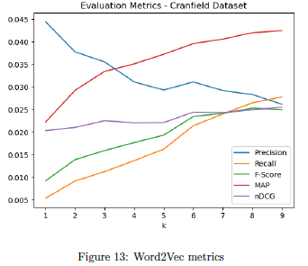
Word embeddings

Slide 8
Conclusion
Ensemble approaches could work better.
Pure weighting schemes perform better than inserting semantic context
Custom search file built using BM25.

